Slide 1
Online Laptop Sales
& Services
Guided by
Dr.Jayashakthi Velumurgan
G. Vikas(192211448)
B. Hari prasad(192210577)
B. Chandra Sainadh Reddy(192210578)

Slide 2

Introduction
1
Passion for Technology
2
Customer-Centric Approach
We are a team of passionate professionals dedicated to providing top-notch laptops and exceptional customer service.
We prioritize your needs and strive to deliver solutions tailored to your specific requirements.
3
Commitment to Quality
4
Innovative Solutions
We stay ahead of the curve by offering the latest technology and innovative features in our laptops.
We meticulously curate our product lineup to ensure we offer only the best quality laptops.

Slide 3

Our product lineup: Laptops for Every Need
Business Laptops
Gaming Laptops
Student Laptops
Designed for productivity, offering powerful processors, ample storage, and long battery life.
Equipped with high-performance graphics cards, fast processors, and immersive displays for optimal gaming experiences.
Durable, lightweight, and affordable laptops ideal for students, offering portability and essential features.

Slide 4

Customizable configurations and upgrades
Processor Choice
Memory Upgrades
Select from a range of processors based on your performance requirements.
Increase RAM capacity to enhance multitasking and responsiveness.
Storage Options
Graphics Enhancements
Choose between SSDs for faster boot times and HDDs for larger storage capacity.
Upgrade to dedicated graphics cards for immersive gaming and graphics-intensive applications.

Slide 5
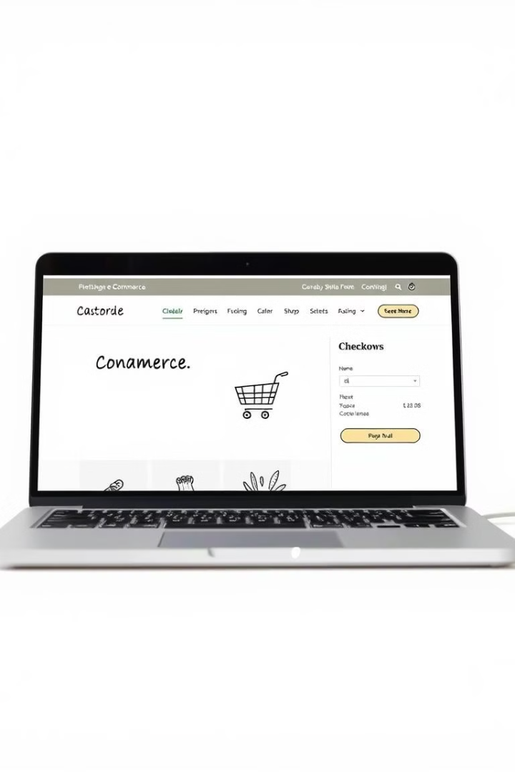





Seamless online ordering and shipping
Browse Products
Explore our extensive catalog of laptops, filter by specifications, and compare models.
Add to Cart
Select your desired laptop, customize configurations, and add it to your shopping cart.
Secure Checkout
Enter your payment information and shipping address securely through our encrypted platform.
Order Confirmation
Receive an email confirming your order details, including estimated delivery date.
Fast Shipping
Your laptop will be carefully packaged and shipped promptly to your doorstep.

Slide 6





Reliable customer service and tech support
Phone Support
Email Support
Reach out to our dedicated team via phone for quick and efficient assistance.
Send us an email with your inquiry and receive a prompt and comprehensive response.
Live Chat
Knowledge Base
Connect with a customer service representative in real time for instant help.
Access a library of helpful articles, FAQs, and tutorials for self-service support.

Slide 7

Sustainable practices and eco-friendly models
1
Energy Efficient Designs
We prioritize laptops with power-saving features to minimize energy consumption.
2
Recycled Materials
We incorporate recycled materials into our laptop manufacturing processes to reduce waste.
3
Eco-Friendly Packaging
We use sustainable packaging materials to minimize our environmental footprint.

Slide 8
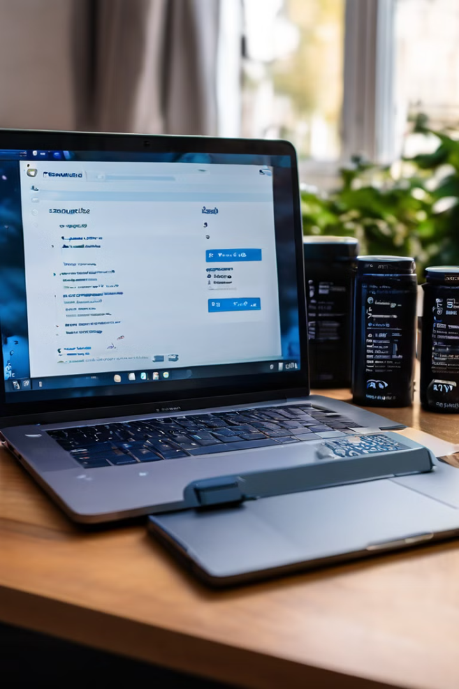
Comparison to competitors
Feature
Our Laptop
Competitor A
Competitor B
Processor
Intel Core i7
Intel Core i5
AMD Ryzen 5
RAM
16GB
8GB
12GB
Storage
512GB SSD
256GB SSD
1TB HDD
Price
$1299
$999
$1199

Slide 9
Drawback’s
Product Quality and Authenticity:
Customers may face issues with the authenticity of products or receiving laptops that don't match the described specifications or quality.
Customer Trust:
Online sales lack the physical assurance that a customer might feel in a store, making trust a significant challenge.
Technical Support Limitations:
Although online support can be provided, some customers may prefer face-to-face interactions for technical issues and repairs.
Logistics and Shipping Delays:
Shipping can be delayed due to logistics issues, which impacts customer satisfaction.
Return and Warranty Issues:
Handling returns and warranty claims online can be complicated and time-consuming for customers.

Slide 10


Testimonials from satisfied customers
Positive Feedback
Excellent Customer Service
“The laptop is fantastic! It's fast, reliable, and perfect for my needs. I highly recommend this company.”
“The customer service team was incredibly helpful and responsive. They resolved my issue quickly and efficiently.”

Slide 11


